Slide 1
Password Prediction
Predicting passwords with the use of a Neural Network
Presentation by: Andrew Buxa

Slide 2
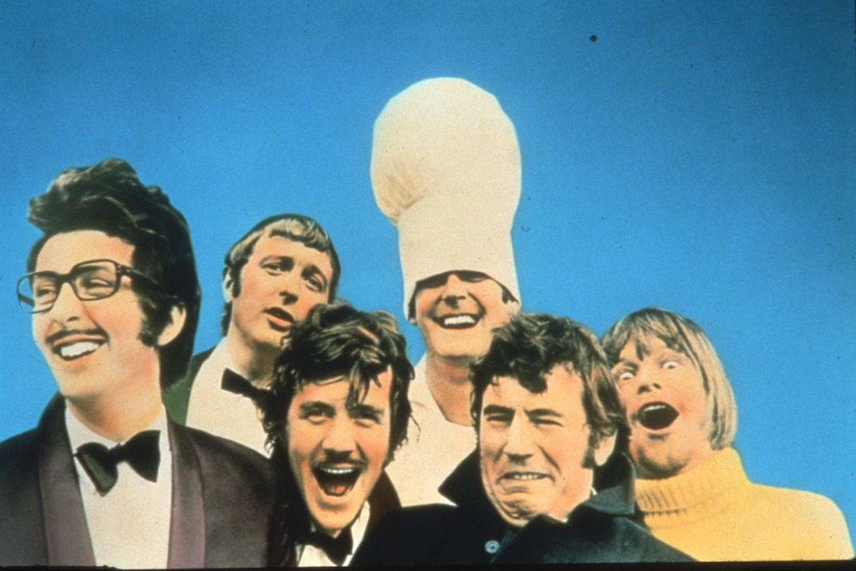


Programming Language

Slide 3
What is a Neural Network?
A Neural Network is an information paradigm that is inspired by the way the human brain processes information. A key element of this paradigm is the structure of the information processing system.
It is composed of a large number of highly interconnected processing elements (neurons) working in unison to solve specific problems.

Slide 4
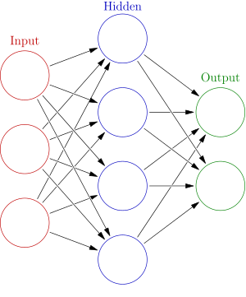

Slide 7
The Hidden Layer
The hidden layer's job is to transform the input layer into something that the output layer can use.
This is done by using an activation function which, defines the value of each neuron (weighted sum of inputs) to an output signal.

Slide 8
My Project: First Step
Generate all permutations of a length-n password.
Example: N1L
Acquire the hexadecimal values for each character.
N 1 L
0x4e 0x31 0x4c
010011100011000101001100 (24 bits)
Run the password through a hashing function (I chose MD5) to acquire the hexdigest.
308b215e470bed6a5ab9c3bad8a9c0c9
00110000100010110010000101011110010001110000101111101101011010100101101010111001110000111011101011011000101010011100000011001001 (128 bits)

Slide 9
My Project: Second Step
Build the data-set for the Neural Network to train on.
Problem encountered (Rookie mistake)
Train the Neural Network

Slide 10
My Project: Step Three
Testing phase:
Run the test data that I generated at random.
Output (In Binary Form): 010111011111100011101100
Actual Binary Password : 010011100011000101001100
512(2^9) possible changes
0.3151294949276715 0 | 0.5743807822672861 1 | 0.2331366269018556 0 | 0.6084900754951604 1 | 0.6937822151637889 1 | 0.6767364244689795 1 | 0.1952870186148312 0 | 0.6352183492251112 1
0.0659696588427606 0 | 0.5975765273912889 1 | 1.046544186085929 1 | 0.6382172693930103 1 | 0.5815946858119168 1 | 0.3412001182348898 0 | 0.03318810785796 0 | 0.4593181073235183 0
0.500510515542972 1 | 0.5297665842844048 1 | 0.6547068739178956 1 | 0.2116742697921304 0 | 0.6490340394859199 1 | 0.7881473715638369 1 | 0.1128701223754646 0 | 0.2325443295673113 0

Slide 11
My Project: Step Four
Calculating Statistics
To see how accurate my Neural Network was, I had to do the following:
Calculate the overall residual value for each set in the test data / amount of passwords in test data.
Calculate the total amount of positions I would have to change in order to get a correct password.

Slide 12
Summary
Neural Networks are good for matching patterns.
The more training, the better.
The results were good, when run on a set password length.

Slide 13
Evaluation Form Questions
Why did you choose this project?
What made it exciting to me?
What would I do differently if I started today?
Enhancements to add

Slide 14
References
http://pages.cs.wisc.edu/~bolo/shipyard/neural/local.html
https://www.doc.ic.ac.uk/~nd/surprise_96/journal/vol4/cs11/report.html#What is a Neural Network
https://en.wikipedia.org/wiki/Artificial_neural_network
http://pybrain.org/
Louis: For putting up with my ignorance on some parts of this program.

